Slide 1


Quantum Imaging with Undetected Photons
Gabriela Barreto Lemos

Slide 2
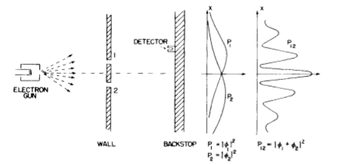
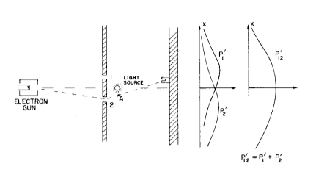
Quantum Interference
“A phenomenon which is impossible, absolutely impossible, to explain in any classical way, and which has in it the heart of quantum mechanics.” – Feynman

Slide 3
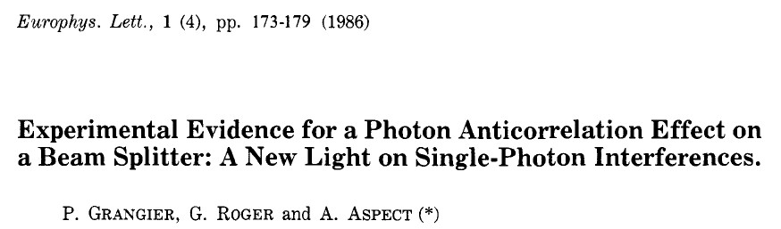
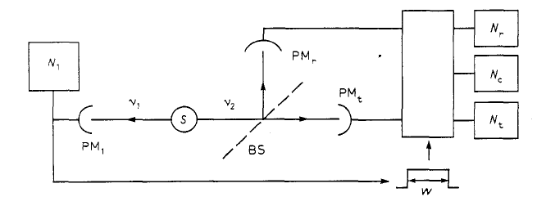
Quantum Interference
“A phenomenon which is impossible, absolutely impossible, to explain in any classical way, and which has in it the heart of quantum mechanics.” – Feynman

Slide 4
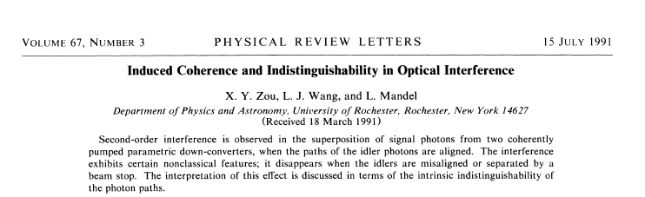
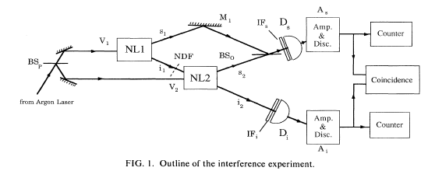

Slide 5
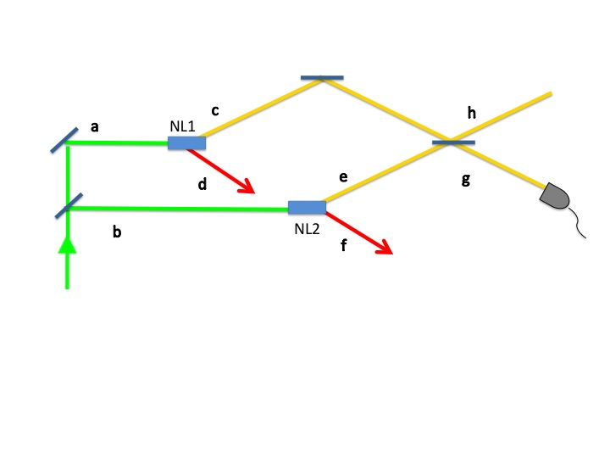

Can the yellow paths interfere?
Two Spontaneous Parametric Down-Conversion sources
Beam
splitter
detector
Laser
NO!
Because d and f carry information as to where the detected yellow photon came from
Notes:
Measurement in singles, but information would be present in coincidences!

Slide 6
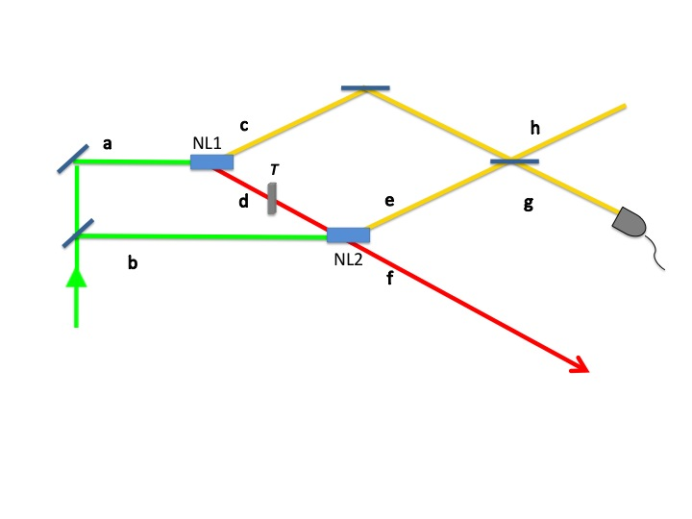
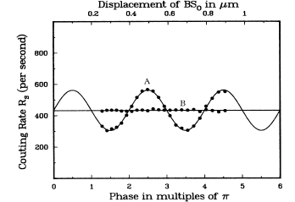
"In quantum mechanics interference is always a manifestation of the
intrinsic indistinguishability of the photon paths, in which case the corresponding probability amplitudes add. "
Can the yellow paths interfere?
NO coincidence detections!
(A)|T|=0.91
(B)|T|=0
Only one pair of photons is generated!
This is NOT two photon interference!
Zou, Wang, Mandel, Phys Rev. Lett. 67, 318 (1991)
Notes:
Measurement in singles, but information would be present in coincidences!

Slide 7
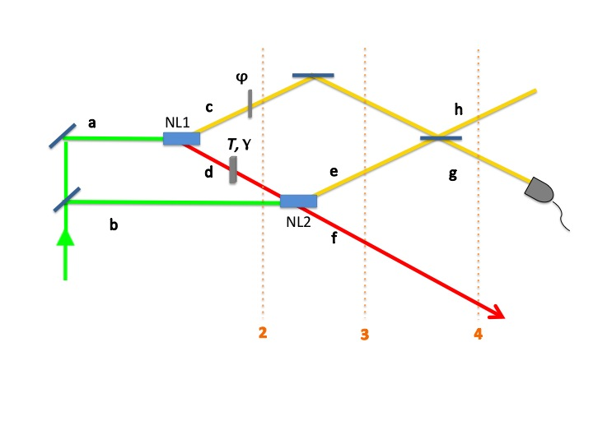
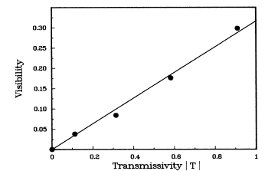
Induced Coherence without Induced Emission
1
3
2
4

Slide 8
Phases
Indistinguishability:
L_{a}+L_{d}=L_{b}
L_{c} –L_{d} - L_{f} = L_{e} –L_{f} L_{c} - L_{d} = L_{e}

Slide 9
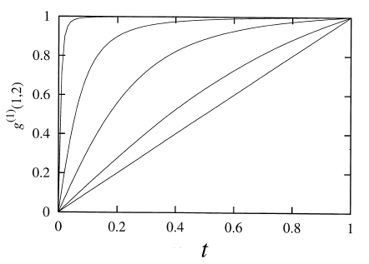

When is interference due to induced emission and when is it due to indistinguishability of quantum transition paths?
T
V
T
Indistinguishability
Induced emission
Ic and Ie don’t depend on T
Ie depends on T
V = T
Wiseman and Molmer, Physics Letters A, 270, 245 (2000)
Notes:
Measurement in singles, but information would be present in coincidences!

Slide 10
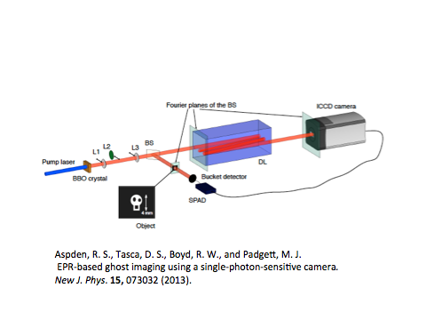
Quantum Ghost Imaging
Image : two-photon correlations (coincidence counts).
First implementation with position momentum entangled photons:
T. B. Pittman, Y. H. Shih, D.V. Strekalov, and A.V. Sergienko,
Phys. Rev. A 52, R3429 (1995).

Slide 11
White, A. G., Mitchell, J. R., Nairz, O. & Kwiat, P. G. ‘‘Interaction-free’’ imaging. Phys.
Rev. A 58, 605–613 (1998).

Slide 12
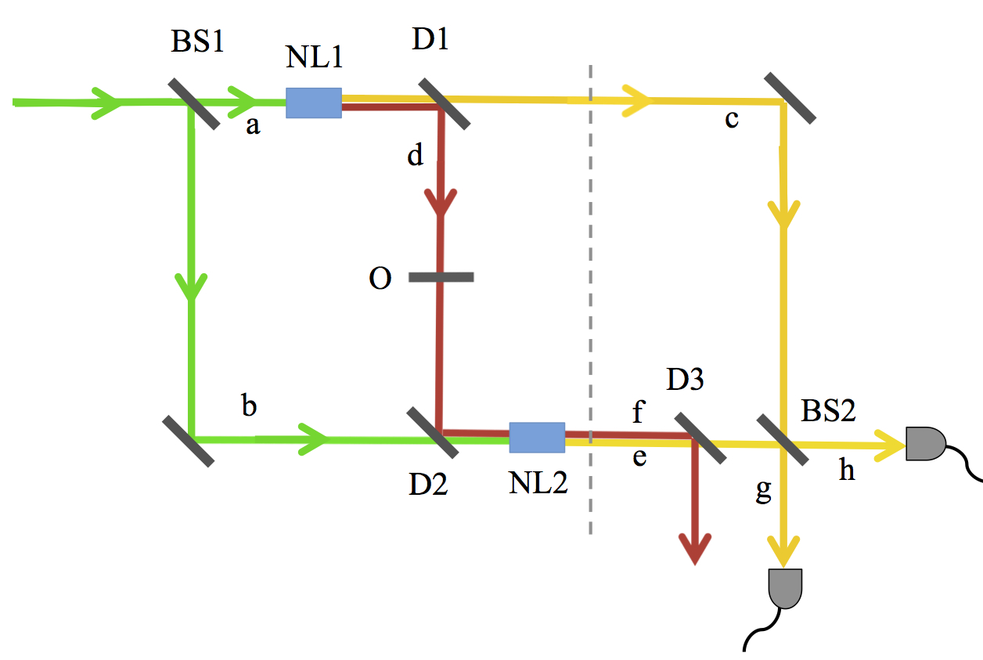
Quantum imaging with Undetected Photons
GBL, V. Borish, S. Ramelow, G. Cole, R. Lapkiewicz, A. Zeilinger
Nature, vol. 512, p. 409 (2014)
No coincidence detections
are necessary!
EMCCD
EMCCD

Slide 13

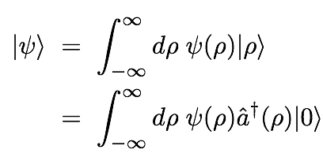
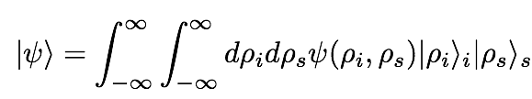
Transverse “position” basis
One photon state
Transverse Spatial
Wave-Function
Two photon state
Notes:
Hilbert space describing transverse degrees of freedom of single photon is spanned by the basis.
An arbitrary pure state is
Distinguishable particles. Paraxial photons!

Slide 14
Imaging
Transverse “position” basis
SPDC state
Object
Notes:
Hilbert space describing transverse degrees of freedom of single photon is spanned by the basis.
An arbitrary pure state is
Distinguishable particles. Paraxial photons!

Slide 15
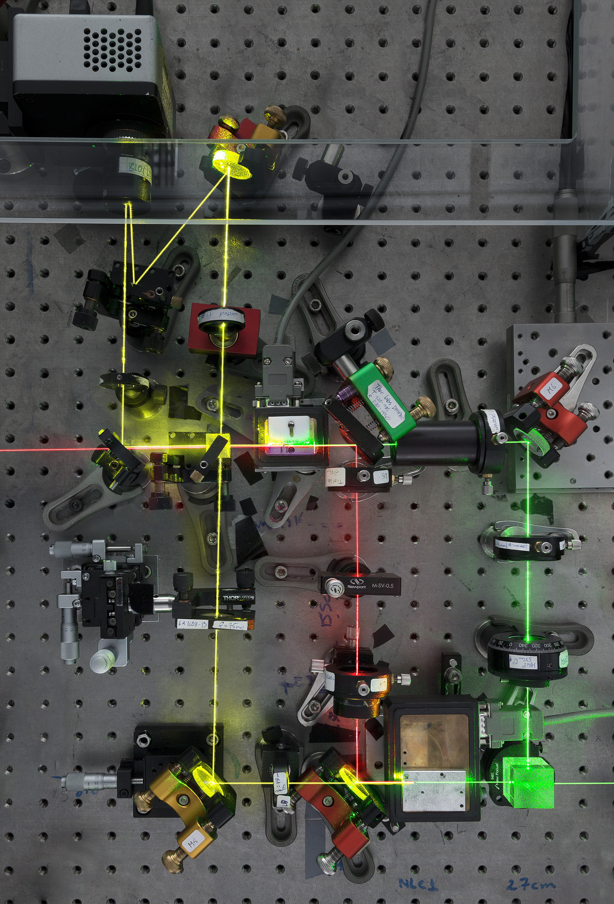
532nm (pump) 810nm (detected) + 1550nm (undetected)
Quantum imaging with Undetected Photons
EMCCD

Slide 16
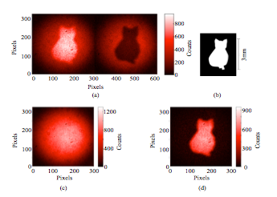
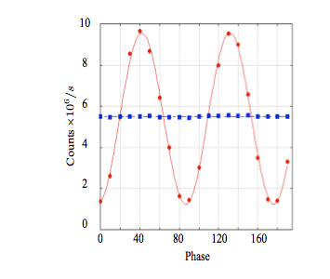
Absorption imaging
Transverse position dependent “which-source” information
Singles 810nm counts at each output
Cardboard
cutout
~78% visibility
Sum of the outputs
Diffference of the outputs
signal beams are not absorbed at all by the mask: important difference to other interferometers

Slide 17
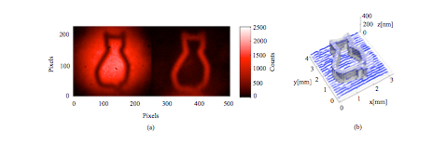
Phase imaging of an opaque object
Phase imaging of an etched silicon plate
(opaque to detected photons)
Singles 810nm counts at each output
Phase is a property of
the bi-photon state
Emerging undetected idler amplitude has a random phase and does not carry the image!

Slide 18
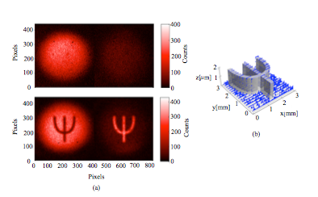

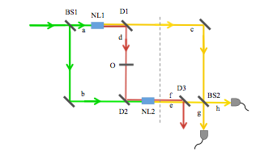
Phase imaging of an invisible object
2 step at detection wavelength
Etched SiO2
step at illumination wavelength

Slide 19
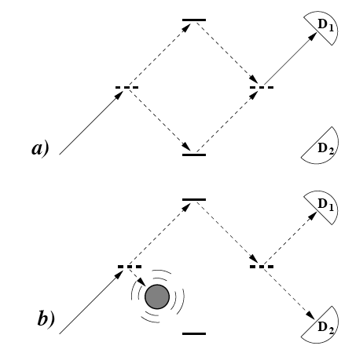
Now detecting idler and signal:
interaction free measurement: P=0.25
Extendable to higher probabilities?
A. C. Elitzur, and L. Vaidman, Found. Phys. 23, 987 (1993).
White, A. G., Mitchell, J. R., Nairz, O. & Kwiat, P. G.
‘‘Interaction-free’’ imaging. Phys. Rev. A 58, 605–613 (1998).
P. Kwiat, H. Weinfurter, T. Herzog, A. Zeilinger, and M.
Kasevich, Phys. Rev. Lett. 74, 4763 (1995).

Slide 20
Spectroscopy with undetected photons
The same “imaging” idea can be extended from transverse spatial domain to the spectral domain
Spectrometer
Singles counts
Singles counts
λ
λ
Constructive and destructive interference with 1550 nm (FWHM 3nm) bandpass filter placed in the undetected idler path

Slide 21
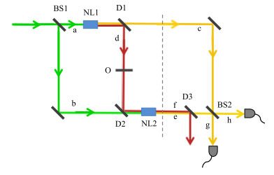

Spectral Fringes
Obtaining the depth or index of refraction of an object using undetected photons
Spectrometer
Object of length L and refractive index gives a phase shift of
λ

Slide 22
Summary
We have shown that information can be extracted about an object without detecting the photons that interacted with it.
We can realise grey scale imaging with the same setup.
It can be used to realise interaction-free imaging.
We can exploit other photonic degrees of freedom. For example, spectrum.
We have seen in single photon detections information that is in fact contained in the bi-photon correlations (phase imaging). What/how much information contained belonging to the bi-photon can be accessed by detecting only one of the systems?

